Slide 1
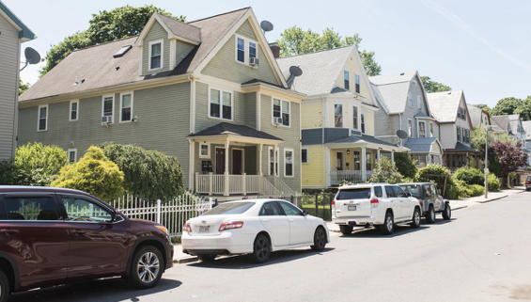

Housing Prices
By: Meghan O’Neill, Sam Mayo, Nikko Higgins, and Maddie Davidson

Slide 2

Executive Summary
Problem : What are the factors that affect a house’s pricing? This analysis is beneficial because it can help home buyers know what a reasonable price for the house is and also help them determine what is important for them in a house. It is also beneficial for people selling a house to know what a reasonable price for the house is.
Data Source : Housing Prices Dataset by M Yasser H from Kaggle.
Methods : Multi-linear regression model, collinearity, and residual plots.
Measures : Variables, p-values of variables, multicollinearity/correlation.
Conclusions : Most significant variable was number of bathrooms, with a positive relationship. The least significant was the area of the house, with a positive relationship. Area, bathrooms, stories, main road, guest room, basement, water heater, air conditioning, preferable are and parking are all significant in predicting a house's price.

Slide 3
Problem Statement : What affects the price of a house?
Dependent Variable : The price of housing.
Independent Variables : Area, Bedrooms, Bathrooms, Stories, Main Road, Guestroom, Basement, Hot Water Heating, Air Conditioning, Parking, Preferred Area, and Furnishing Status.
Strategy : Develop a multi-variable regression model to estimate the price of a house.

Slide 4
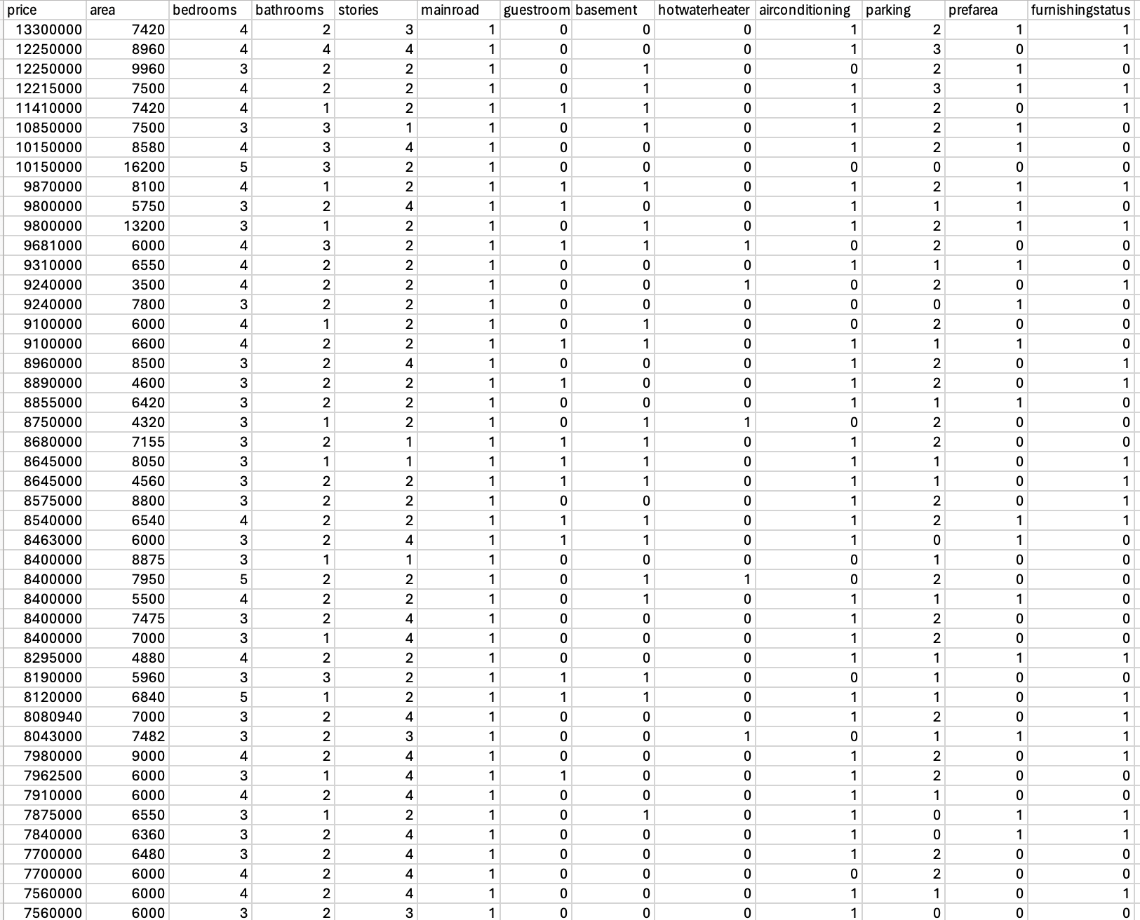
Methodology: Data Preparation
Data preparation
Downloaded excel file
Changed yes/no to 1/0
Cleaned up the data
Removed the yes/no columns to make the regressions possible

Slide 5
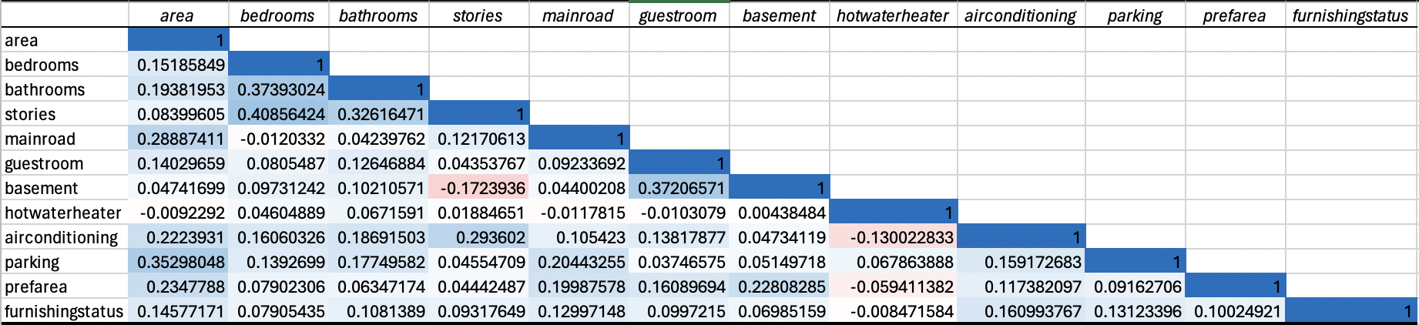
Methodology: Multicollinearity

Slide 6
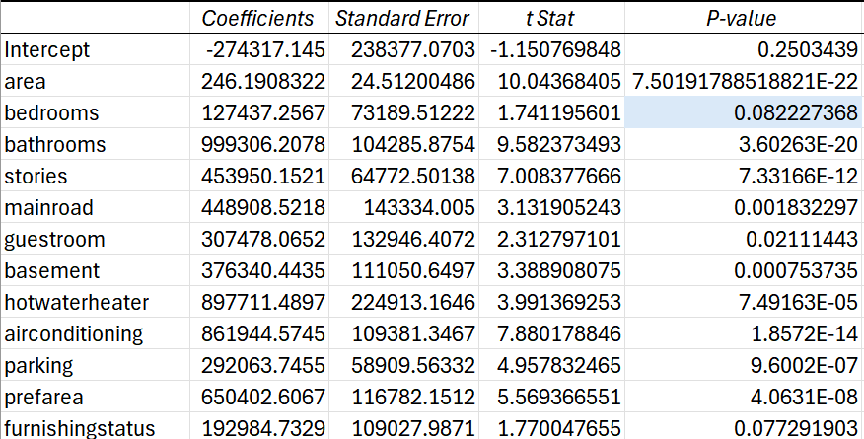
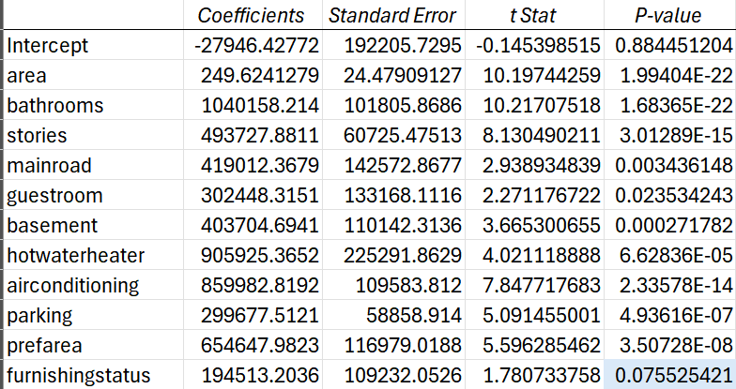
Methodology: Removing High P-Values
We removed the variables that had a greater p-value than alpha of 0.05:
Bedrooms
Furnishing status

Slide 7
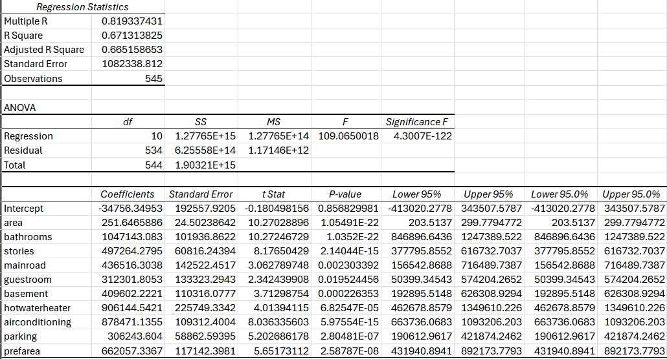
Final Regression

Slide 8
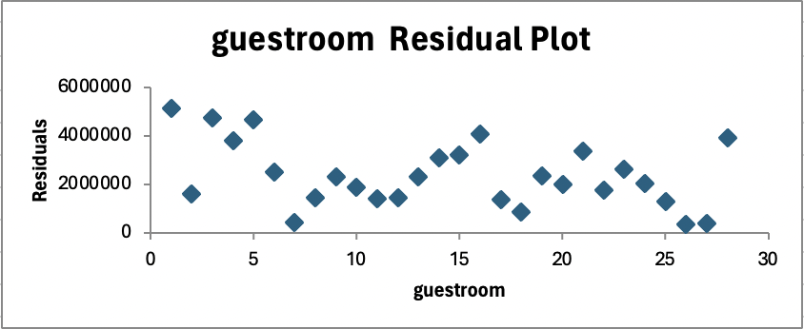
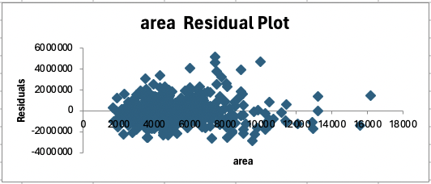
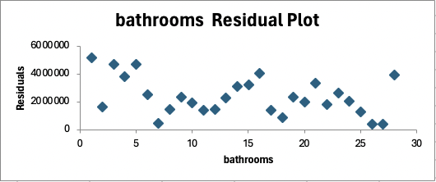
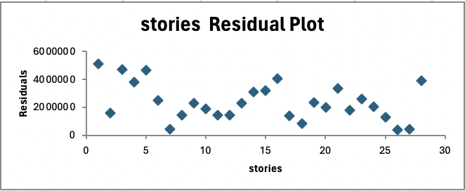
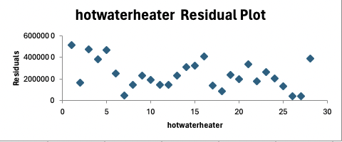
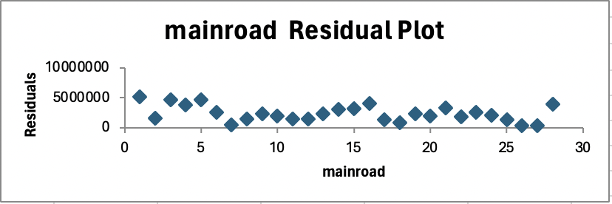
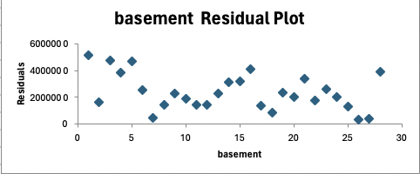
Methodology: Residual Plots

Slide 9

Parsimonious Model
A=
Area
Selling Price = -34756.35 + 251.65A + 1047143.08B + 497264.28C + 436516.30D + 312301.81E + 409602.22F + 906144.54G + 878471.14H + 306243.60I + 662057.34J
B=
Bathrooms
C=
Stories
D=
Main Road
E=
Guest Room
F=
Basement
G=
Water Heater
I= Parking
J=
Preferable Area
H=
Air Conditioning

Slide 10
Conclusion
In the beginning we started with 12 variables: area, bedrooms, bathrooms, stories, main road, guest room, basement, water heater, air conditioning, parking, preferable area and furnishing status.
Due to high p-values we took out 2 variables: bedrooms and furnishing status.
We ran a final regression model to identify the most and least significant variables.

Slide 11
Conclusion Continued
Most Significant
Number of bathrooms is the most significant variable as it has the largest coefficient. The relationship between price and number of bathrooms is positive.
Least Significant
Area is the least significant variable as it has the smallest coefficient. The relationship between price and area is positive.

Slide 12
Citations
H, M Yasser. “Housing Prices Dataset.” Kaggle, 12 Jan. 2022,
www.kaggle.com/datasets/yasserh/housing-prices-dataset.
Data Set
https://iowa-my.sharepoint.com/:x:/r/personal/sammayo_uiowa_edu/Documents/Housing.xlsx?d=w02c0a54b152f4653893335a617b07564&csf=1&web=1&e=YKKOO7

